Slide 1
Drupal
Santosh Kalwar
01.09 – 02.09

Slide 2
Drupal Recap
Previously
We improved our custom theme a bit
Created a very basic custom module
You practised creating a basic custom module
You installed the devel plugin and web profiler

Slide 3
Today Topics
Continue improving our custom theme a bit
Practices 1-3 devel generate
Drupal Views: Overview
Practice Drupal Views
Convert articles to table
Add views in a block
Add tab in content section
Expose filter in admin content section
Look into hooks implementation for our custom module
You practice creating a hook for your custom module
Create another simple module for links in Drupal
Group work
Group work presentation

Slide 4
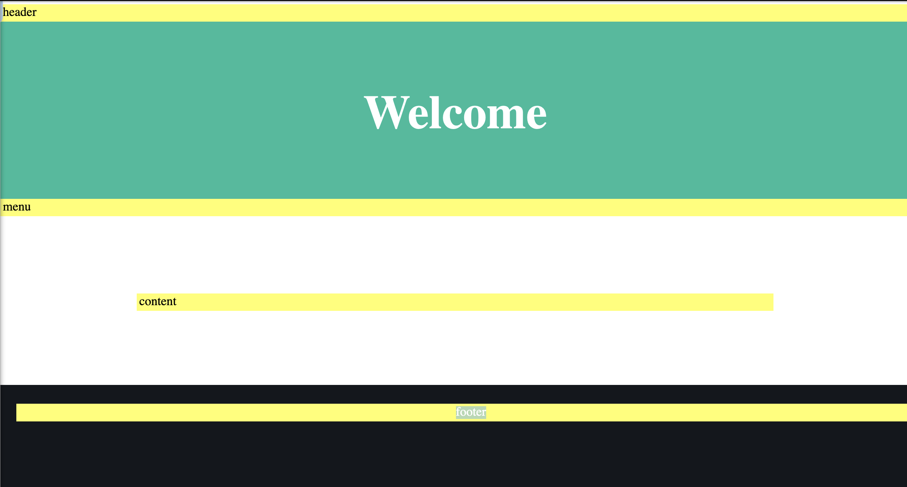
Continue Improving our custom theme a bit

Slide 5
devel generate to automatically generate contents
Very Useful if you want to generate dummy Drupal contents
You can also use “Realistic Dummy Content” module with devel generate
Provides freely licensed images, and stock photography

Slide 6
Practice 01: Use Devel generate
Use devel to generate 15 nodes automatically
Use devel to generate 20 nodes with 4 comments using lando drush command
You can try following commands
lando drush genc 20 4
20 – 20 nodes, number of nodes to generate
4 – 4 comments, max number of comments
Delete previously created nodes
lando drush genc 20 4 --kill

Slide 7
Practice 02: Use Devel generate
Use devel to generate 15 blogs and articles
You can use the following command
lando drush genc 15 4 --bundles=blog_post,article
You can use options such as
--feedback
--skip-fields
--languages
You can also try other commands for other entity types
lando drush generate-menus (drush genm)
lando drush generate-users (drush genu)

Slide 8
Practice 03: Use Devel generate
Download the Realistic Dummy Content module
https://www.drupal.org/project/realistic_dummy_content
And use devel to generate 5 blogs and articles
lando drush generate-content (drush genc)
Do you see any difference from Devel generate?

Slide 9
Drupal Views
Views selects, orders, and presents your content or any part of it based on the criteria you define
Originally it was part of Contrib module
As of Drupal 8, it is now part of core module
Many Drupal sites are now using Views
Imagine Views as visiting library and asking librarian
e.g.
I need a book published before 2015
Whose author last name starts with “K”
Where the book has more than 100+ pages and cover is in Blue

Slide 10
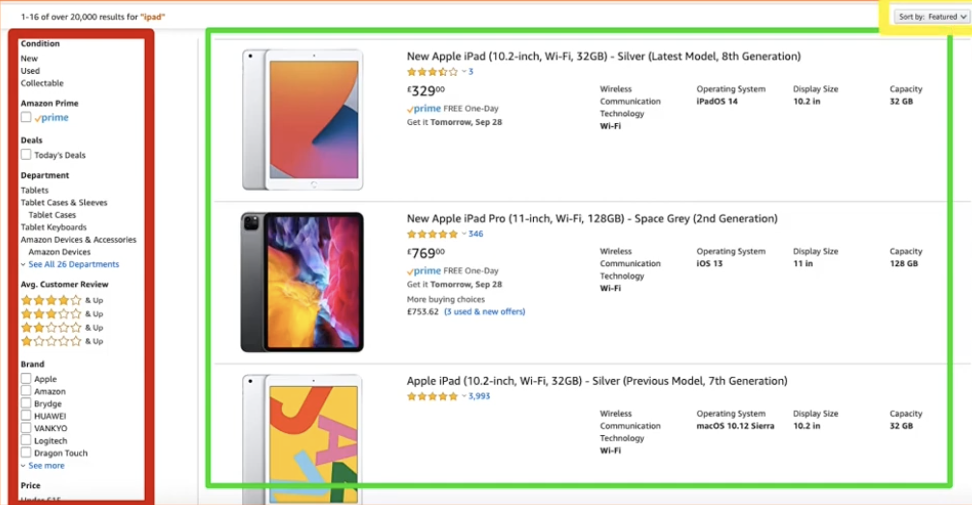
Drupal Views
And, would you please sort them in publication date order, then by the last name …
In online shopping, you have similar views

Slide 11
Drupal Views
Go to Extend menu
Search for “Views”
Make sure “Views” and “Views UI” is enabled
Make sure you have some content in your local drupal (e.g. you can use devel generate to generate content)
Go to Structure → Views
To create a new view, just click on Add View
Provide view name: “Latest articles.”
View settings: Content
Of type “Article” sorted by “Newest first.”
You can enable “Create a page” → Save and edit

Slide 12
Practice 04: Convert articles to table 1/3
Go to Structure → Views
Search for the view you just created e.g. “latest-articles”
Select “edit”
Click on Format → “Unformatted list”
Change it to “Table” and you will see dialog
Go with default option
Click on Fields → Add
Search for “body” → enable body →Add and configure field→ Apply
Select “Content: Body (Body)” field, change Formatter to “Trimmed” →Trimmed limit → 200 → Apply

Slide 13
Practice 04: Convert articles to table 2/3
Click on Fields → Add
Search for “authored on” → enable “authored on” →Make sure the category is “Content.”→ Add and configure the field
Change Date format: HTML Date format: YYYY-MM-DD
Check the preview
Click on Fields → Add
Search for “Image” → Add and configure the field
From Image style→ change it to “Thumbnail” and Link image to → Content → Apply
Check the preview

Slide 14
Practice 04: Convert articles to table 3/3
Re-order or arrange the table columns
In the Fields → select dropdown → Rearrange
Drag and drop the arrangements → Apply
Check the preview
Click on “Save” in the views section
Go now to Back to the site

Slide 15
Practice 05: Add views in a block 1/2
Go to Structure→ Views
Search the view which you have created, e.g. “latest-article”
Under Displays → Click on “Add”→Block → Save
Block will look similar to the page, except there will be “Block settings”
Change your theme to Olivero
You can now go to Structure→Block Layout
Search for Sidebar → Place block→Latest articles→ Place block→ Save block

Slide 16
Practice 05: Add views in a block 2/2
Select “Block” from Views settings section
Select any of the fields to override the block fields e.g. “Content: Title”
Select the view which you have created, e.g. “latest-article” → For “This block (override)”→ Apply
You will see that the “Block” from Views is in Italics format
Remove “Body”, and “Authored On” columns from fields
Click on “Save”
Go back to your site and see modified views block

Slide 17
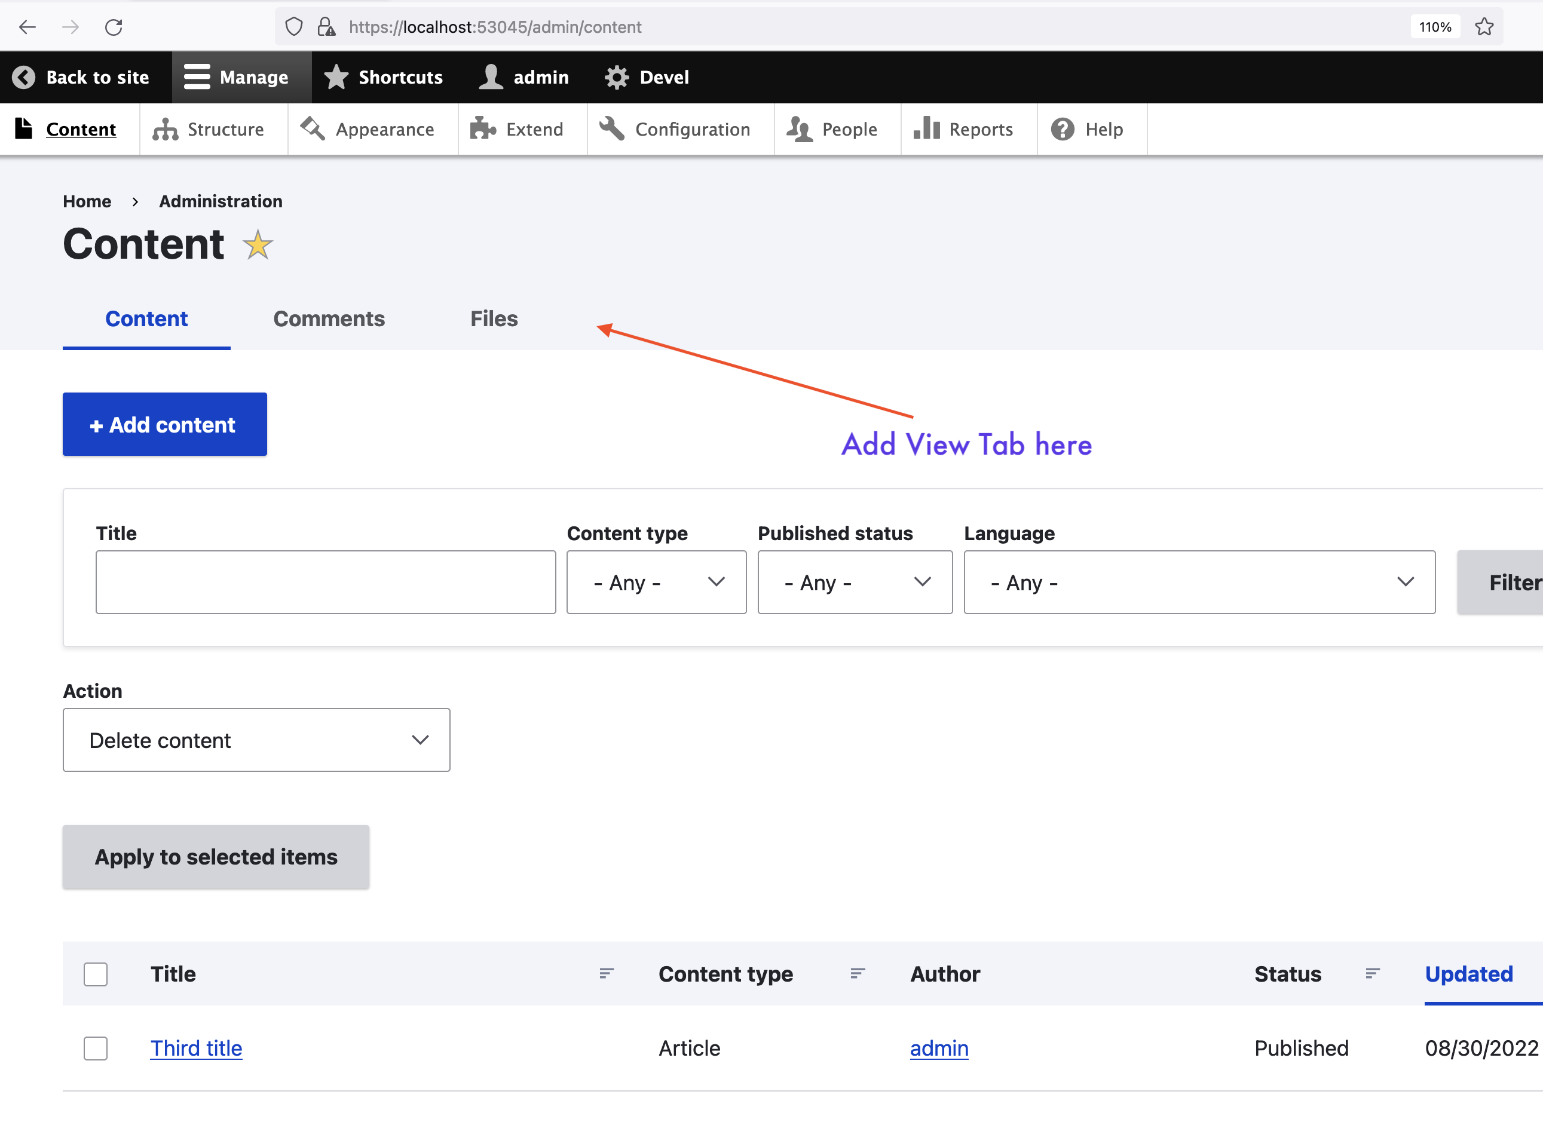
Practice 06: Add view tab in admin content section

Slide 18
Practice 06: Add view tab in admin content section
Go to Structure → Views
Select your view e.g. “latest-articles” →edit
Go to page settings, click on path
Change the path to admin/content/latest-articles→ Apply
Select Menu: No menu
Change the menu type to “Menu tab”
Insert the Menu link title: Latest articles
Under Parent: <Administration>
Select Apply -→ Save View
Go to Content and check a new view tab

Slide 19
Practice 07: Change view tab in admin permission
Go to Structure → Views
Grab the URL and Open a new tab in other browser now you see the content section is visible
You can change the permission in View section
Change permission from “View published content” to “Access the Content overview page”
Grab the URL and Open a new tab in other browser now you see the content section should require permission.

Slide 20
Practice 08: Expose search filter in content section
Go to Structure → Views
Click on Add Filter criteria
In For: This page (override)
Search: ”title”
Select Title with category Content → Apply (this display)
Then tick checkbox on “Expose this filter to visitor, to allow them to change it”
In Operator box you can change the criteria to “Contains”
Now you click on Apply (this display) → Save your view
You go to admin content section

Slide 21
Hooks implementation for our custom module
Hooks are one of the ways for modules to interact with contributed modules or Drupal core subsystems.
The purpose of the hook is to provide Drupal with some help text about what the module does.
Let us add a hook by creating a file
E.g. first_module.module
The format should be “module_name_hook_name” format where
hook_name is replaced by the name of the hook being implemented
hook must go inside a .module file
After the implementation, you check the hook from “help” menu
https://drupalize.me/tutorial/what-are-hooks?p=2766
https://www.drupal.org/docs/creating-custom-modules/understanding-hooks

Slide 22
Practice 09: Add hook for your own custom module
Follow steps from previous slide
Create your function for hook
See the changes in Drupal site

Slide 23
Create another simple custom module
Let us assume we want a module which helps us navigate between various admin pages and to front pages
And let us also assume we cannot find it from Drupal site
Requirement is such that users can use this module to
Go to block admin page
Go to content admin page
Go to user admin page
Go to front page of the site
Go to external link

Slide 24
Create another simple custom module
You create a module structure
E.g. links_example.info.yml
Links_example.routing.yml
We continue in the controller together
Devel “Routes Info” gives us more info about routes
block.admin_display
system.admin_content
Entity.user.collection
Optional/Extra: can you add hook_help() for this module?
https://api.drupal.org/api/drupal/core!lib!Drupal!Core!Link.php/class/Link/9.4.x
https://api.drupal.org/api/drupal/core%21lib%21Drupal%21Core%21Url.php/class/Url/9.4.x

Slide 25
Group work 1/2
In this group work, your task is to select one of these 7 modules.
Environmental indicator https://www.drupal.org/project/environment_indicator
Field group module https://www.drupal.org/project/field_group
Pathauto module https://www.drupal.org/project/pathauto
SecKit module https://www.drupal.org/project/seckit
Content Locking https://www.drupal.org/project/content_lock
Web Form https://www.drupal.org/project/webform
Backup and Migrate https://www.drupal.org/project/backup_migrate

Slide 26
Group work 2/2
Install, and Use one of these contributed modules with your teammates
Work in teams and find out how this module works
Do you think this module would be useful?
In what situations? And use-cases
Create a short presentation (steps, pic, screenshots)
Present your findings to everyone

Slide 27
Group Presentation
Group presentation will start at 13:45
Max 5-10 minutes per group
Others will evaluate the presentation and provide feedback in itsLearning -> Group work results
Ask questions and answers
Note: Remember not to vote for your own group
Upload the slides in Group work folder in itsLearning

